Slide 1
Workflows and best practices for collaborative coding in R
Dr Caitie Kuempel
@cdkuempel

Slide 2
Housekeeping and disclaimers
Assuming you are familiar with R, Rstudio and Github
More lecture and less tutorial today
Please speak up and comment in the chat window with comments, questions, useful tips
I’m a conservation scientist – I learned everything I know from you and twitter
Also this means I’m speaking from an academic perspective
I’m still learning, but always trying to improve ☺
Special thanks to Dr Alexa Fredston (@Afredston) for providing materials for this talk

Slide 3
Outline
Tools, tips and tricks for:
Organizing your data
Coding workflows, best practices, reproducibility
Project management
Collaborating across skill levels and programming languages

Slide 4

Speaking of Twitter….
Twitter has an amazing R community
”Tidy Tuesday”
Ask questions and get answers
Learn about new packages, useful tips, etc.
@RLadiesBrisbane
@hadleywickham (Chief Scientiest at Rstudio)
@JennyBryan (Software engineer atRstudio)
@Allison_horst
For how to get started see here

Slide 5
Why does it matter?
A good project layout will ultimately make your life easier:
Makes it easier to understand the pipeline from source data to final product
Helps ensure the integrity of your data
Makes it simpler to share your code with someone else
Allows you to easily upload your code with your manuscript or project
Makes it easier to pick the project back up after a break
“Your greatest enemy is yourself four months ago” – every grad student ever
Notes:
Need to change your mindset!

Slide 6
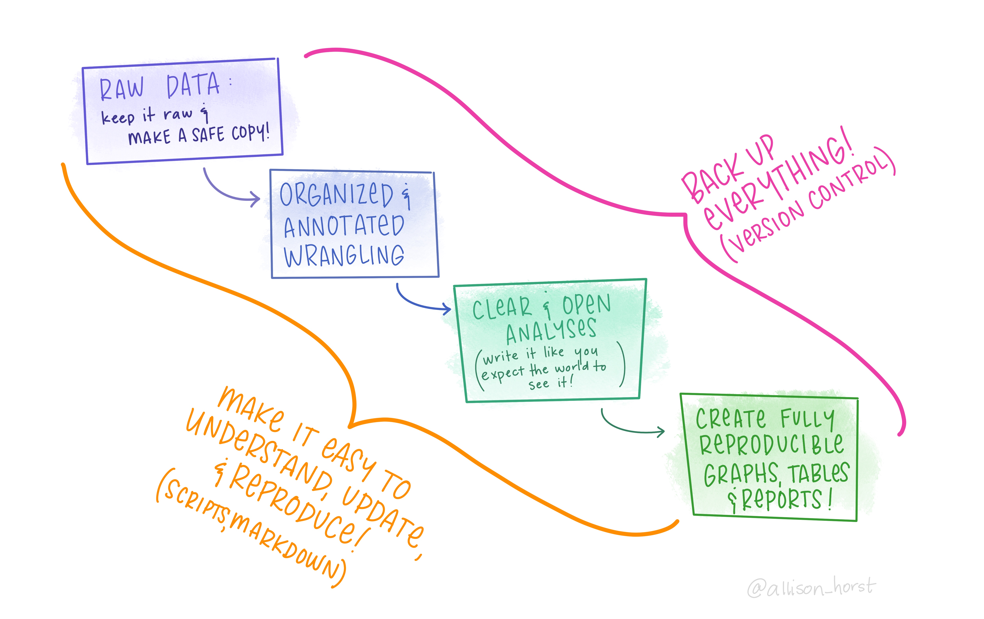

Slide 7
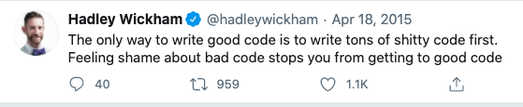
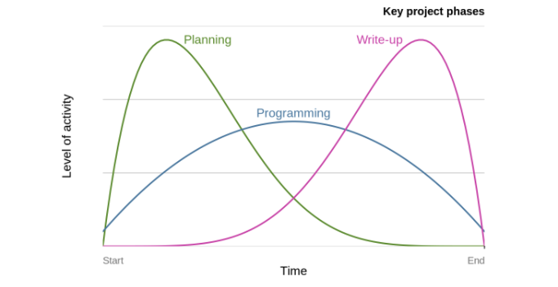
Organizing your data
Anticipate your code and data will be published (or shared widely) with every completed project/paper
Deposit in archives
FigShare
Knowledge Network for Biocomplexity (KNB)
Put some thought into it – map out steps before you start
Write in code headings
Treat raw data as read only
Raw_data directory that is never modified
Web scraping/APIs

Slide 8
Organizing your data
Web scraping/APIs
Allows others to reproduce your results directly from scripts without requiring any additional data files
Several R packages allow you to communicate with services to access data from R
Some conservation related examples
Rerddap
Rfishbase
Rnaturalearth
Rtweet
rredlist
Others?
You can also write your own API in R

Slide 9
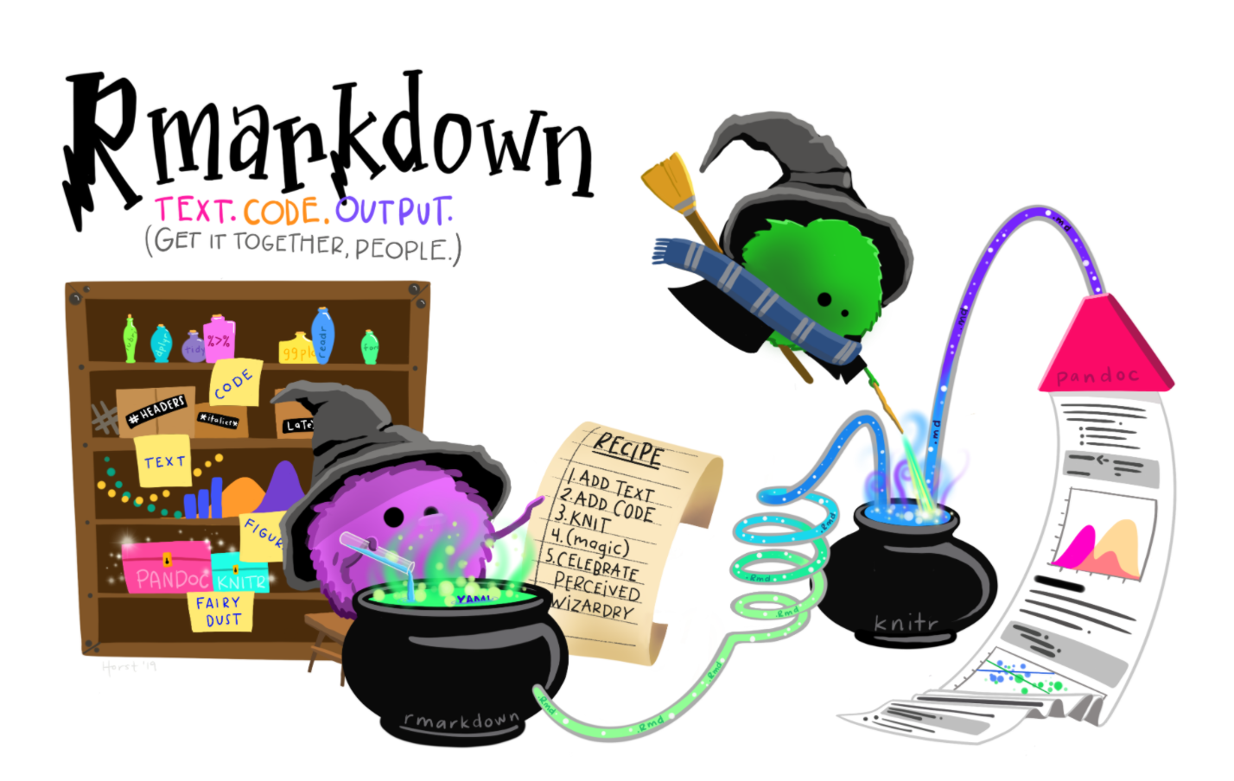
Organizing your data
Best practices
Use projects – one folder per project
Keeps everything organized, self-contained, increases reproducibility
Can work on multiple projects at once
Rmarkdown
Pros
Easily combines text, code and outputs
Allows results of R code to be directly inserted into formatted documents
Easy to use
You can even write entire papers or theses – check out bookdown
Cons: Can be clunky with large analyses
Use portable file paths – no absolute paths!
here() package

Slide 10
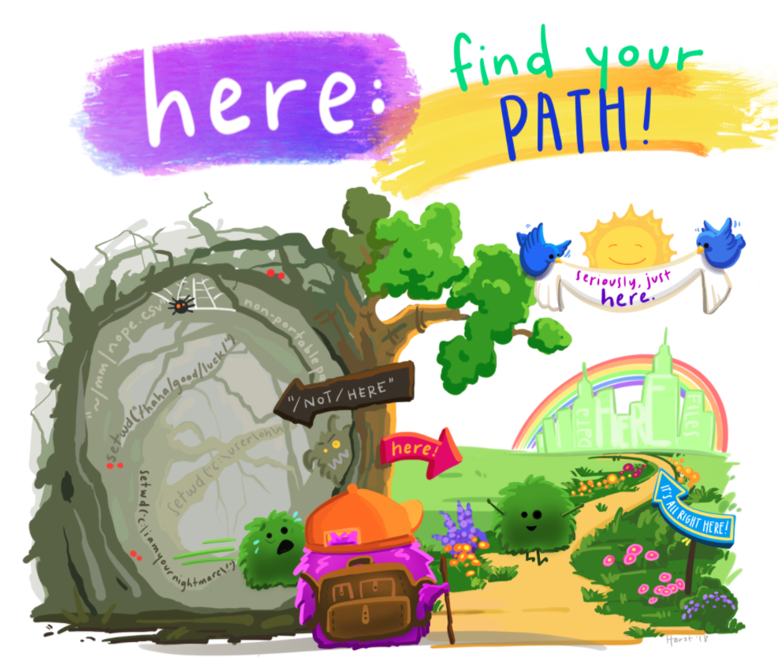
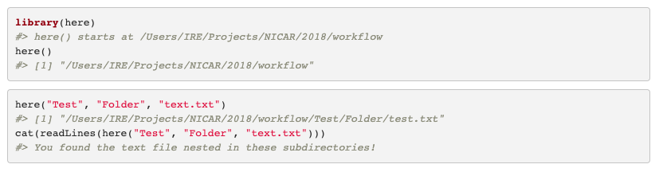
here() package
Do you have setwd() in your scripts?
This makes your script fragile, hard-wired to exactly one time and place.
here() sets the file.path() to the top-level of the current project
Notes:
This makes your script very fragile, hard-wired to exactly one time and place. As soon as you rename or move directories, it breaks. Or maybe you get a new computer? Or maybe someone else needs to run your code? We show a very accessible way to go cold turkey and eliminate the setwd() gotcha from your code.

Slide 11
Organization your data
As a general rule:
1 script = ~1 task (or no more than one section of Methods)
List decision points/user choices at the top so it’s obvious what they are
Some examples from my work:
A bad script
A better script

Slide 12
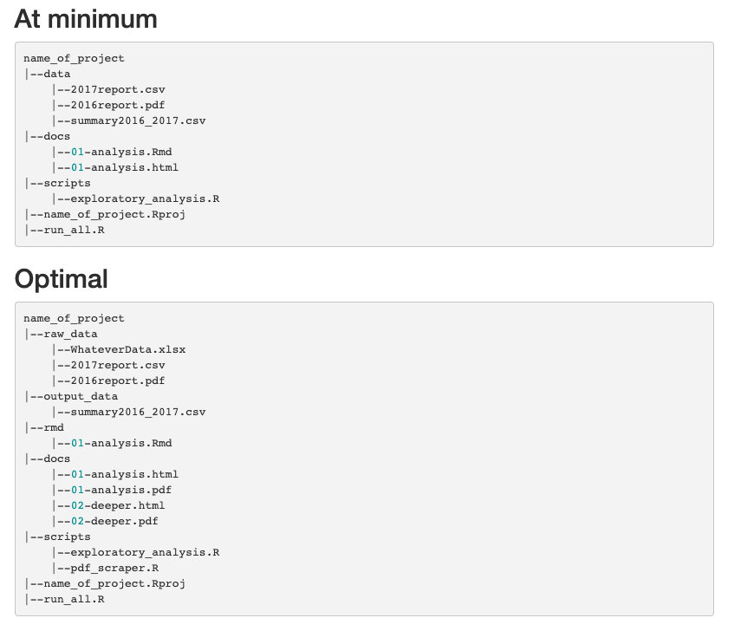
Organizing your data
Best practices
File organization
workflow
usethis
startR

Slide 13
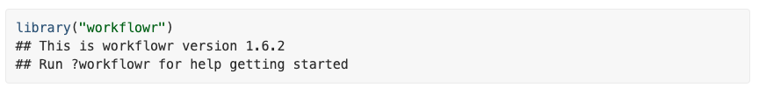
workflowR
A R package that helps scientists organize their research in a way that promotes effective project management, reproducibility, collaboration and sharing of results

Slide 14
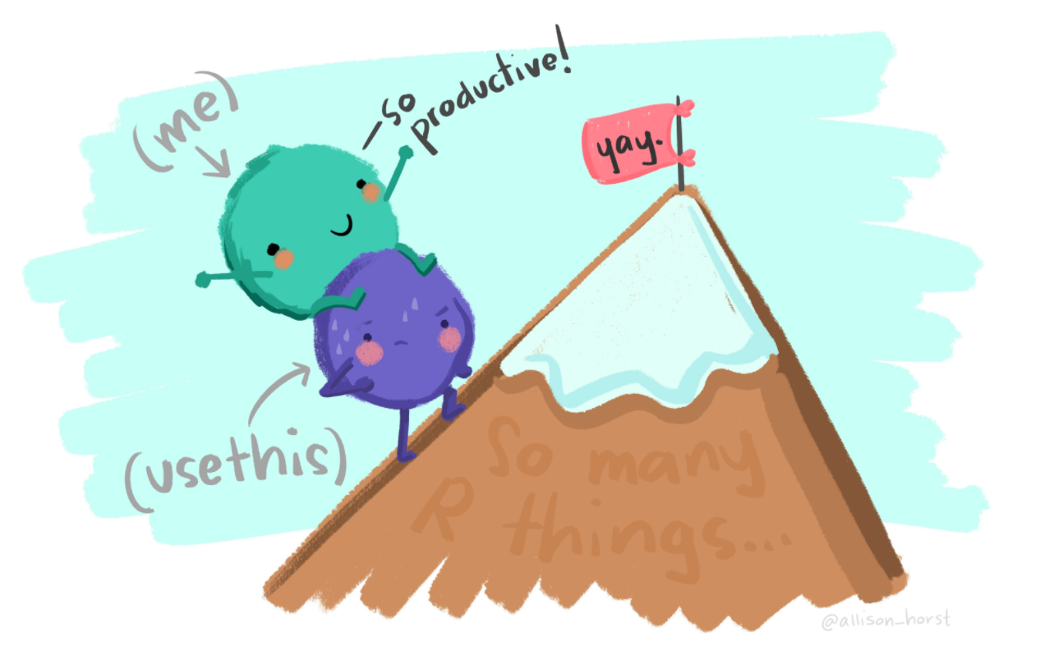
usethis
For package development
Automates repetitive tasks that arise during project setup and development, both for R packages and non-package projects
create_project()
use_git()
use_github()

Slide 15
Project management and Collaboration
Top tips for efficient collaboration
Describe what each code does
Readme.md
Have a consistent coding style
R style guides
http://adv-r.had.co.nz/Style.html
Be concise, clear and consistent
With comments and formatting!
Avoid repeating yourself!
Functions, “source” from other scripts - example
Think carefully about your comments and keep them up to date
Use version control whenever possible
Use informative commit messages
Don’t be afraid to ask for feedback from colleagues
Notes:
https://csgillespie.github.io/efficientR/collaboration.html

Slide 16
Project management and Collaboration
Describe what each code does
Readme.md
Have a consistent coding style
R style guides
http://adv-r.had.co.nz/Style.html
Be concise, clear and consistent
With comments and formatting
Avoid repeating yourself!
Data import (iterate over list of file names)
Data cleaning/tidying
Applying many models
Generating and saving plots
Simple functions can be within a script, complex or functions used in multiple scripts can live in a functions folder/script.
Apply functions using apply, purrr or for loops
Parallel processing = mclapply or pbmclapply
Notes:
https://csgillespie.github.io/efficientR/collaboration.html

Slide 17
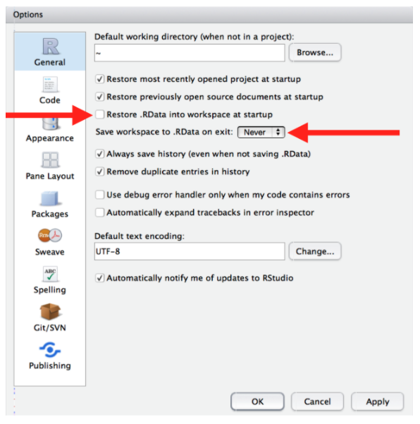
Project management and Collaboration
Do not save workshops to .Rdata
Short-term pain – R will not remember the results of the code that you ran last time
Long-term gain – forces you to capture all important interactions in your code
Use version control!
Github issues
Useful whether or not everyone codes
Github projects
Notes:
The RData format (usually with extension . rdata or . rda) is a format designed for use with R, a system for statistical computation and related graphics, for storing a complete R workspace or selected "objects" from a workspace in a form that can be loaded back by R

Slide 18
Project management: day to day
Try to pause coding when a task is complete
Leave a to-do list for others (and yourself) of what still needs to happen for the script to be functional
Pull + commit + pull + push frequently
Restart R frequently (ensures right packages are loaded)

Slide 19
Project management and Collaboration
Agree on shared practices for data storage, script development, communication, etc. at the start of a project and document them in a Google doc
Example

Slide 20
Project management and Collaboration
Check if they have a “how we work document” and/or set some basic guidelines and follow them
Editing other people’s code
Be constructive, be nice!
Check if they have any contribution guidelines
Fix bugs if you see any
There are many, many, many ways to do the same thing in R – all of them “correct”, some more efficient (runtime/key strokes) or easier to understand

Slide 21
Project management and Collaboration
Collaborating across different open-source programming languages
Extra important to have good communication and division of tasks
Can still use git for version control of scripts
Write out and read in data in flexible formats that translate across the languages you are using
R packages
Reticulate lets you run Python code from Rstudio (still need to understand Python a bit)
Other ideas?

Slide 22
Collaboration
Collaborating across different open-source programming languages
Many scientists feel strongly about using ArcGIS, Matlab, etc.
Best practices about version control and data management still apply
Half a reproducible project is better than none
Make data to reproduce results publicly available when at all possible

Slide 23
Collaboration
For collaborators who code, but aren’t using best practices
Share some of the tools/tips you have learned here
Offer to help set up and maintain reproducible workflow for/with them
A little organization and planning to go a long ways – it doesn’t have to be hard to use tools and it doesn’t have to be “perfect” to contribute
For collaborators who don’t really code:
Use GitHub for communication (Issues) and sharing data and figures
Rmarkdown/Shiny to show code and results
Rmarkdown interface to Microsoft Word (has anyone tried this?)
Google Docs > Microsoft Word
People are worth more to projects than tools
Other thoughts?

Slide 24
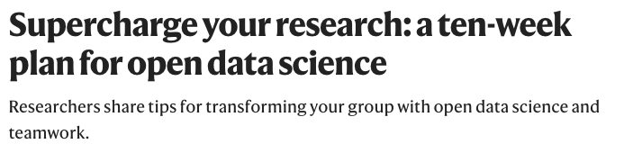
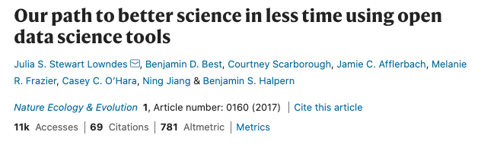
Collaboration
Getting people on board
Share resources and offer to help
Start coding clubs/hacky hours in your organization

Slide 25
Questions?
Questions for me???
Some questions for you!
What has been your biggest hurdle for workflows and collaborative coding in R? How are you handling it now? What might you try differently in the future?
Do you normally make your code/data available when a project is complete? If yes, what tools do you use? If no, what is the biggest barrier?
Any tools/tips/tricks that you love that weren’t mentioned in the talk?
How many people are usually working on a project with (or planning to?) at one time? Any success stories to share with the group?
What area (e.g., data organization, project management, collaboration, etc.) do you want to try to improve the most from your workflow?

Slide 26
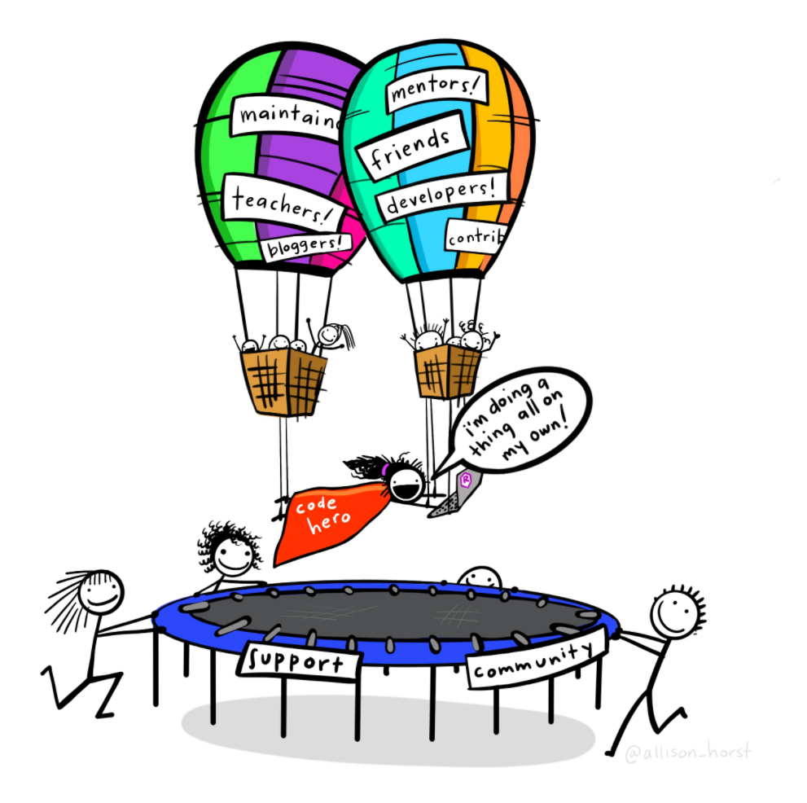
Thanks!
Follow me on twitter @cdkuempel
Get in touch if you would like to present at a future Rladies meeting or have a topic you would like to see covered

